Slide 1
Unit 6 Application Of AI

Slide 2
Biological Neuron
A nerve cell (neuron) is a special biological cell that processes information.
According to an estimation, there are huge number of neurons, approximately 10¹¹ with numerous interconnections, approximately 10¹⁵.

Slide 3
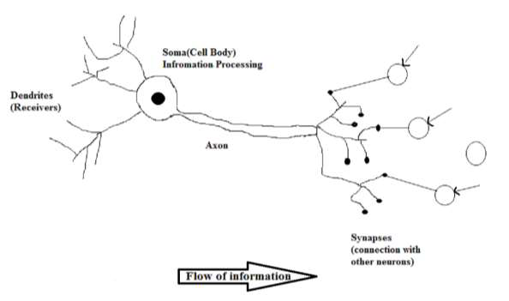
Biological Neuron

Slide 4
Biological Neuron
Working of a Biological Neuron
As shown in the above diagram, a typical neuron consists of the following four parts with the help of which we can explain its working:
Dendrites: They are tree-like branches, responsible for receiving the information from other neurons it is connected to. In other sense, we can say that they are like the ears of neuron.
Soma: It is the cell body of the neuron and is responsible for processing of information, they have received from dendrites.
Axon: It is just like a cable through which neurons send the information.
Synapses: It is the connection between the axon and other neuron dendrites.

Slide 5
Biological Neural Networks
Neuron is a cell in brain whose principle function is the collection, Processing, and dissemination of signals.
Networks of such neurons is called neural network .
Neural network is capable of information processing.
It is also known as:
Connectionism
Parallel and distributed processing and
neural computing.

Slide 6
What is a Artificial Neural Network?
An Artificial Neural Network (ANN) is an information processing paradigm(model) that is inspired by the way biological nervous systems process information.
The key elements of this paradigm are:
Nodes(units): Nodes represent a cell of neural network.
Links: Links are directed arrows that show propagation of information from one node to another node.
Activation: Activations are inputs to or outputs from a unit.
Weight: Each link has weight associated with it which determines strength of the connection.
Activation function: A function which is used to derive output activation from the input activations to a given node is called activation function.

Slide 7
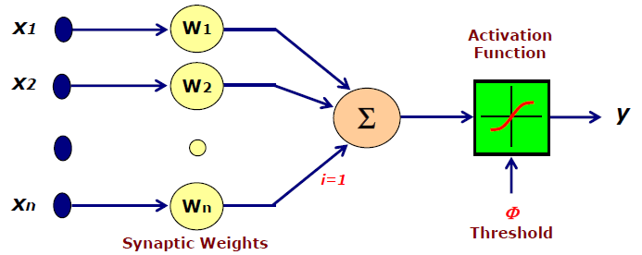
Contd….

Slide 8
Why use neural networks?
Ability to derive meaning from complicated or imprecise data.
Other reasons for using the ANNs are as follows:
Adaptive learning: An ability to learn how to do tasks based on the data given for training or initial experience.
Self-Organization: An ANN can create its own organization or representation of the information it receives during learning time.
Real Time Operation: ANN computations may be carried out in parallel
Fault Tolerance via Redundant Information Coding: Partial destruction of a network leads to the corresponding degradation of performance. However, some network capabilities may be retained even with major network damage

Slide 9
Neural networks versus conventional computers
Parallelism is NNs characteristics, because the computations of its components are largely independent of each other. Neural networks and conventional algorithmic computers are not in competition but complement each other.
Different approach used to problem solving is the main difference between neural networks and conventional computers.
Conventional computers use an algorithmic approach, for instance, the conventional computer follows a set of instructions in order to solve a problem.
Thus, the specific steps must be well-defined so that the computer can follow to solve the problem.
This rule restricts the problem solving ability of conventional computers. That means the computer must be given exactly how to solve a problem.

Slide 10
Neural networks versus conventional computers
As for neural networks, information is processed in much a similar way the human brain does.
A NN consists of a large amounts of highly interconnected processing elements--neurons which works in parallel to solve a specific problem.
Neural networks can learn by examples but they cannot be programmed to perform a specific task like conventional computers.
Moreover, the examples must be selected carefully otherwise it might be functioning incorrectly or waste time.
This problem arises because of no method found currently to testify if the system is faulty or not.

Slide 11
Basic model of ANN
Processing of ANN depends upon the following three building blocks:
Network Architecture(interconnections)
Adjustments of Weights or Learning rules
Activation Functions
Basic Models of ANN
Interconnections
Learning rules
Activation function

Slide 12
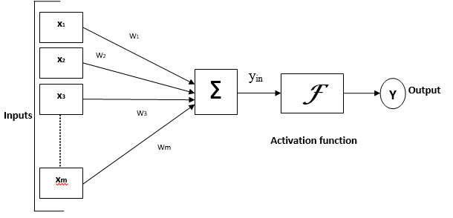
First artificial neurons: The McCulloch-Pitts model
The McCulloch-Pitts model is an extremely simple artificial neuron as shown in figure below:

Slide 13
Contd..
In the figure, the variables w₁, w_{2,} w_{3….. Wm} are called "weights". x₁, x₂, x_{3,… Xm} represent the inputs.
Net input can be calculated as a weighted sum of its inputs (actual input):
Net Input = x₁w₁ + x₂w₂ + x₃w₃ + ...+x_{m}w_{m}=
Then check if (Net input < Threshold) or not (i.e., apply the activation function to the Net Input to derive the output).
If it is, then the output is made zero.
Otherwise, it is made a one.
Note: The inputs can be either a zero or a one. And the output is a zero or a one.

Slide 14
Activation functions
It is also known as the transfer function.
Activation function typically falls into one of three main categories:
Linear activation function
Piecewise , and
Ramp
Threshold activation function
Step, and
sign
Sigmoid activation function
Binary, and
Bipolar

Slide 15
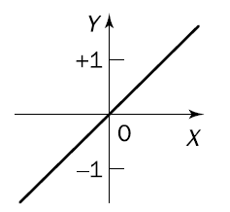
Linear Activation
Also known as identity activation function. For linear activation functions, the output activity is proportional to the total weighted sum(Net Input).
Output (Y)= mx + c, where m and c are constant
Neurons with the linear function are often used for linear approximation.

Slide 16
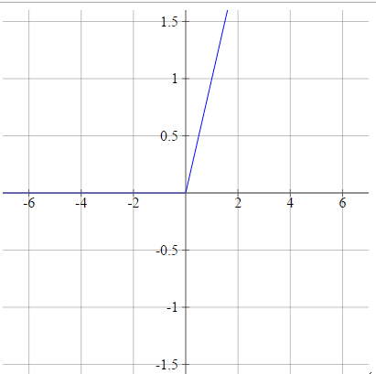
Contd..
Linear activation functions are of two types:
Piecewise, And
Ramp
Ramp Linear activation function:
Also known as Rectifier, or Max.
Output(Y) = Max(0, Net input)

Slide 17
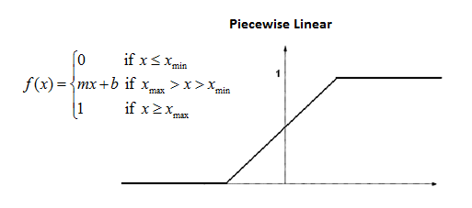
Contd…
Piecewise Linear Activation:
Choose some x_{min} and x_{max} which is our "range".
Everything less than this range will be 0, and everything greater than this range will be 1.
Anything else is linearly-interpolated between.
Here x is net input, and
f(x) is output

Slide 18
Threshold(Unit ) activation Function
Also known as hard limit functions. For threshold activation functions, the output are set at one of two levels, depending on whether the Net_input is greater than or less than some threshold value.
Threshold activation functions are of two types:
Step activation function ,and
sign activation function.
hard limit functions, are often used in decision-making neurons for classification and pattern recognition tasks.

Slide 19

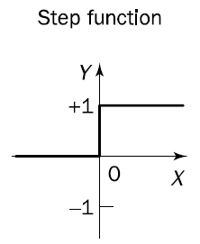
Step(Binary) activation
output ( y)

Slide 20

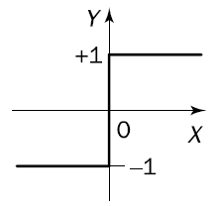
Sign(Bipolar) activation
Output(Y)

Slide 21
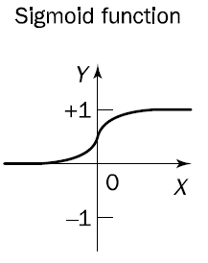
Sigmoid Activation Function
For sigmoid activation functions, the output varies continuously but not linearly as the input changes.

Slide 22

Sigmoid Activation Function
It is of two type as follows:
Binary sigmoid function:
This activation function performs input editing between 0 and 1. It is positive in nature. It is always bounded, which means its output cannot be less than 0 and more than 1. It is also strictly increasing in nature, which means more the input higher would be the output. It can be defined as:
output (Y)

Slide 23

Sigmoid Activation Function
Bipolar sigmoid function:
This activation function performs input editing between -1 and 1. It can be positive or negative in nature. It is always bounded, which means its output cannot be less than -1 and more than 1. It is also strictly increasing in nature like sigmoid function. It can be defined as
Output(Y)

Slide 24
First artificial neurons: The McCulloch-Pitts model
The McCulloch-Pitts model is an extremely simple artificial neuron as shown in figure below:

Slide 25
Contd..
In the figure, the variables w₁, w_{2,} w_{3….. Wm} are called "weights". x₁, x₂, x_{3,… Xm} represent the inputs.
Net input is calculated as a weighted sum of its inputs:
Net Input = x₁w₁ + x₂w₂ + x₃w₃ + ...+X_{m}W_{m}=
Then check if (Net input < Threshold) or not (i.e., apply the activation function to the Net Input to derive the output).
If it is, then the output is made zero.
Otherwise, it is made a one.
Note: The inputs can be either a zero or a one. And the output is a zero or a one.

Slide 26
Logic Gates with MP Neurons
We can use McCulloch-Pitts neurons to implement the basic logic gates.
All we need to do is find the appropriate connection weights and neuron thresholds to produce the right outputs for each set of inputs.

Slide 27
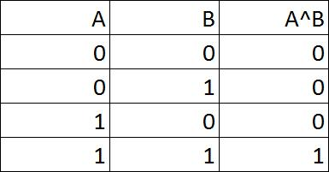
Realization of AND gate
Looking at the logic table for the A^B, we can see that we only want the neuron to output a 1 when both inputs are activated.

Slide 28
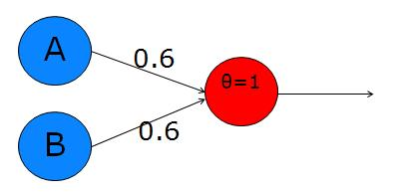
Contd..
To do this, we want the sum of both inputs to be greater than the threshold, but each input alone must be lower than the threshold.
Let's use a threshold of 1 (simple and convenient!). So, now we need to choose the weights according to the constraints :
E.g., 0.6 and 0.6
With these weights, individual activation of either input A or B will not exceed the threshold, while the sum of the two will be 1.2, which exceeds the threshold and causes the neuron to fire. Here is a diagram:

Slide 29
Contd…
Here, letter theta denote the threshold.
A and B are the two inputs. They will each be set to 1 or 0 depending upon the truth of their proposition.
The red neuron is our decision neuron. If the sum of the weighted inputs is greater than the threshold, this will output a 1, otherwise it will output 0 .
So, to test it by hand, we can try setting A and B to the different values in the truth table and seeing if the decision neuron's output matches the A^B column:

Slide 30
Contd..
If A=0 & B=0 --> 0*0.6 + 0*0.6 = 0. This is not greater than the threshold of 1, so the output = 0. Good!
If A=0 & B=1 --> 0*0.6 + 1*0.6 = 0.6. This is not greater than the threshold, so the output = 0. Good.
If A=1 & B=0 --> exactly the same as above. Good.
If A=1 & B=1 --> 1*0.6 + 1*0.6 = 1.2. This exceeds the threshold, so the output = 1. Good.

Slide 31
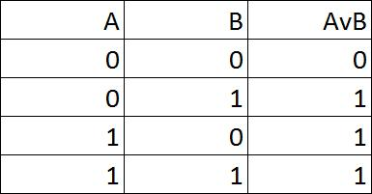
Realization of OR Gate
Logic table for the OR GATE is as shown in below:
In this case, we want the output to be 1 when either or both of the inputs, A and B, are active, but 0 when both of the inputs are 0.

Slide 32
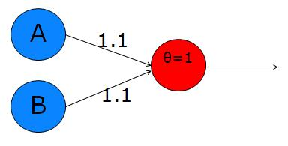
Contd..
This is simple enough. If we make each synapse greater than the threshold, then it'll fire whenever there is any activity in either or both of A and B. This is shown in figure below. Synaptic values of 1.1 are sufficient to surpass the threshold of 1 whenever their respective input is active.

Slide 33
Realization of NOT Gate
Logic table for the NOT gate is as shown in table below:
The NOT operator simply negates the input, When A is true (value 1), ¬A is false (value 0) and vice-versa.
A | ¬ A
0 | 1
1 | 0

Slide 34
Contd...
This is a little tricky. We have to change a 1 to a 0 - this is easy, just make sure that the input doesn't exceed the threshold.
However, we also have to change a 0 to a 1 - how can we do this?
The answer is to think of our decision neuron as a tonic neuron - one whose natural state is active.
To make this, all we do is set the threshold lower than 0, so even when it receives no input, it still exceeds the threshold.
In fact, we have to set the synapse to a negative number (here use -1) and the threshold to some number between that and 0 ( use -0.5).

Slide 35

Contd..
The decision neuron shown below, with threshold -0.5 and synapse weight -1, will reverse the input: A = 1 --> output = 0 A = 0 --> output = 1

Slide 36
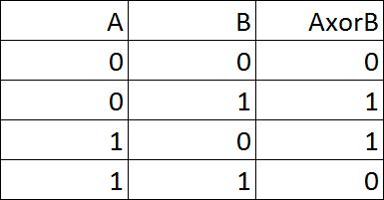
Realization of XOR Gate
XOR (exclusive OR) operator actually put a spanner in the works of neural network research for a long time because it is not possible to create an XOR gate with a single neuron, or even a single layer of neurons - we need to have two layers.
The truth table for the XOR gate is as shown below:

Slide 37
Contd..
Exclusive OR means that we want a truth value of 1 either when A is 1, or when B is 1(i.e. A and B have different truth value), but not when both A and B are 1 or 0(i.e., both have same truth value).
The truth table on the above shows this.
To use a real world example, in the question "would you like tea or coffee?", the "or" is actually and exclusive or, because the person is offering you one or the other, but not both. Contrast this with "would you like milk or sugar?". In this case you can have milk, or sugar, or both.

Slide 38
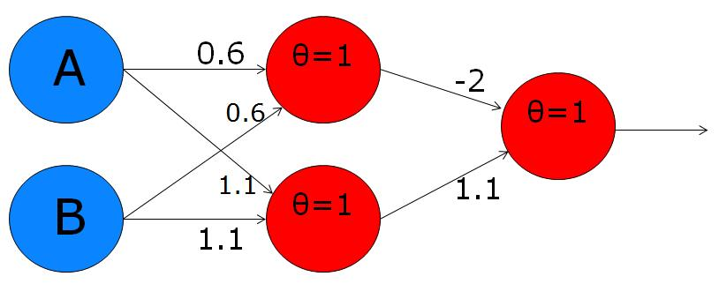
Contd..
The only way to solve this problem is to have a bunch of neurons working together. start by breaking down the XOR operation into a number of simpler logical functions:
A xor B = (AvB) ^ ¬(A^B)
This line of logic contains three important operations: an OR operator in the brackets on the left, an AND operator in the brackets on the right, and another AND operator in the middle.
We can create a neuron for each of these operations, and stick them together like this:

Slide 39
Contd..
The upper of the two red neurons in the first layer has two inputs with synaptic weights of 0.6 each and a threshold of 1, exactly the same as the AND gate we made earlier. This is the AND function in the brackets on the right of the formula wrote earlier.
Notice that it is connected to the output neuron with a negative synaptic weight (-2). This accounts for the NOT operator that precedes the brackets on the right hand side.
The lower of the two red neurons in the first layer has two synaptic weights of 1.1 and a threshold of 1, just like the OR gate we made earlier. This neuron is doing the job of the OR operator in the brackets on the left of the formula.
The output neuron is performing another AND operation - the one in the middle of the formula. Practically, this output neuron is active whenever one of the inputs, A or B is on, but it is overpowered by the inhibition of the upper neuron in cases when both A and B are on.

Slide 40
Learning in Neural Networks:
Learning:
Learning in neural networks is carried out by adjusting the connection weights among neurons.
There is no algorithm that determines how the weights should be assigned in order to solve specific problems. Hence, the weights are determined by a learning process
Learning may be classified into two categories:
Supervised Learning
Unsupervised Learning

Slide 41
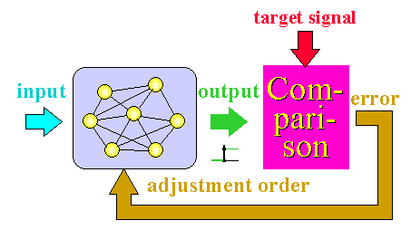
Learning in Neural Networks:
1) Supervised Learning:
In supervised learning, the network is presented with inputs together with the target (teacher signal) outputs.
Then, the neural network tries to produce an output as close as possible to the target output by adjusting the values of internal weights.
The most common supervised learning method is the “error correction method”.
Neural networks are trained with this method in order to reduce the error (difference between the network's output and the desired output) to zero.

Slide 42
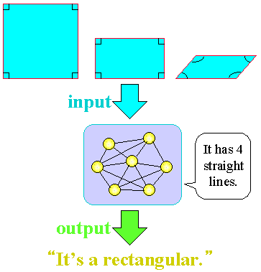
Learning in Neural Networks:
2) Unsupervised Learning:
In unsupervised learning, there is no teacher (target signal/output) from outside and the network adjusts its weights in response to only the input patterns
A typical example of unsupervised learning is Hebbian learning.

Slide 43
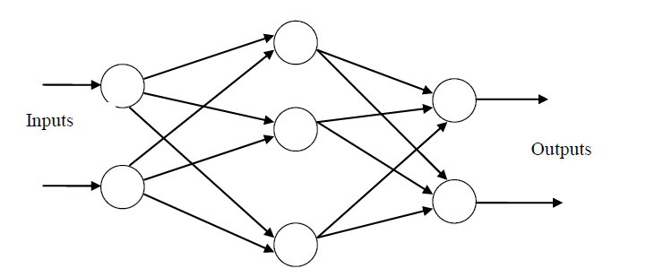
Network Architecture
1) Feed-forward networks:
Feed-forward ANNs allow signals to travel one way only; from input to output.
There is no feedback (loops) i.e. the output of any layer does not affect that same layer.
Feed-forward ANNs tend to be straight forward networks that associate inputs with outputs.

Slide 44
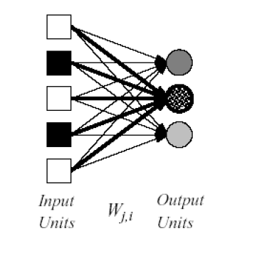
Types of Feed Forward Neural Network:
a) Single-layer neural networks
A neural network in which all the inputs connected directly to the outputs is called a single-layer neural network.

Slide 45
Types of Feed Forward Neural Network:
Single-layer Feed Forward neural networks :
Two types:
Perceptron, and
ADLINE

Slide 46
Perceptron
Developed by Frank Rosenblatt by using McCulloch and Pitts model, perceptron is the basic operational unit of artificial neural networks.
It employs supervised learning rule and is able to classify the data into two classes.
Operational characteristics of the perceptron:
It consists of a single neuron with an arbitrary number of inputs along with adjustable weights, but the output of the neuron is 1 or -1 depending upon the input. It also consists of a bias whose weight is always 1.
Following figure gives a schematic representation of the perceptron.

Slide 47
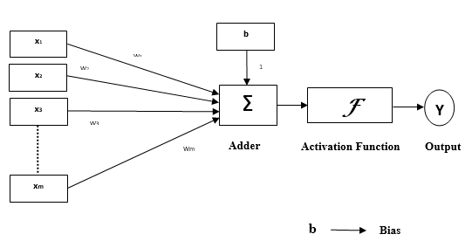
Perceptron
Following figure gives a schematic representation of the perceptron:

Slide 48
Perceptron
Perceptron thus has the following three basic elements:
Links: It would have a set of connection links, which carries a weight including a bias always having weight 1.
Adder: It adds the input after they are multiplied with their respective weights. It also add up the bias.
Activation function: It limits the output of neuron. The most basic activation function is a sign function that has two possible outputs. This function returns 1, if the input is positive, and -1 for any negative input.

Slide 49
Adaptive Linear Neuron (ADALINE)
ADALINE which stands for Adaptive Linear Neuron, is a network having a single linear unit.
It was developed by Widrow and Hoff in 1960. Some important points about ADALINE are as follows:
It uses bipolar activation function.
It uses delta rule for training to minimize the Mean-Squared Error (MSE) between the actual output and the desired/target output.
The weights and the bias are adjustable.

Slide 50
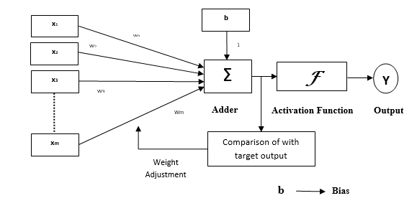
Adaptive Linear Neuron (ADALINE)
Architecture :
The basic structure of ADALINE is similar to perceptron having an extra feedback loop with the help of which the calculated output is compared with the desired/target output.
After comparison on the basis of training algorithm, the weights and bias will be updated.

Slide 51
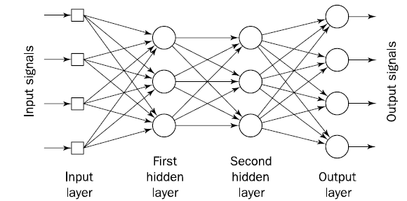
Types of Feed Forward Neural Network:
b) Multilayer neural networks
The neural network which contains input layers, output layers and some hidden layers also is called multilayer neural network.

Slide 52
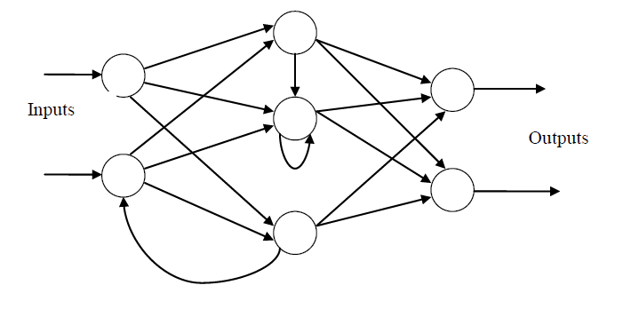
Network Architectures
2) Feedback networks (Recurrent networks:)
Feedback networks can have signals traveling in both directions by introducing loops in the network.
very powerful
extremely complicated.
dynamic: Their 'state' is changing continuously until they reach an equilibrium point.
also known as interactive or recurrent.

Slide 53
Applications of Neural Network
Speech recognition
Optical character recognition
Face Recognition
Pronunciation (NETtalk)
Stock-market prediction
Navigation of a car
Signal processing/Communication
Imaging/Vision
….

Slide 54
Natural Language processing
What is Natural language:
Natural language refers to the way we, humans, communicate with each other.
English, Spanish, French, and Nepali are all examples of a natural language.
Natural communication takes place in the form of speech and text.

Slide 55
What is Natural Language processing
Natural language processing is a technology which involves converting spoken or written human language into a form which can be processed by computers, and vice versa.
The goal of NLP is to make interactions between computers and humans feel exactly like interactions between humans and humans.

Slide 56
Components of NLP
Because computers operate on artificial languages, they are unable to understand natural language. This is the problem that NLP solves.
With NLP, a computer is able to listen to a natural language being spoken by a person, understand the meaning of it, and then if needed, respond to it by generating natural language to communicate back to the person.
There are two components of NLP as given
Natural Language Understanding (NLU)
Natural Language Generation (NLG)

Slide 57
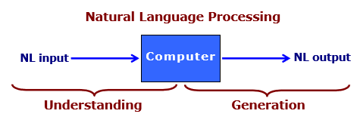
Contd…

Slide 58
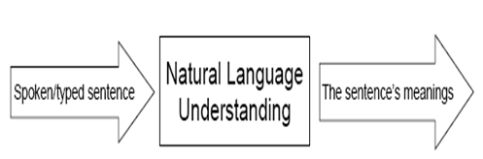
Natural language Understanding(NLU):
The most difficult part of NLP is understanding, or providing meaning to the natural language that the computer received.
To understand a language a system should have understanding about:
structures of the language including what the words are and how they combine into phrases and sentences.
the meanings of the words and how they contribute to the meanings of the sentence and
context within which they are being used

Slide 59
Natural language Understanding:
But, Developing programs that understand a natural language is a difficult and challenging task in the AI due to the following reasons:
Natural languages are large: They contain infinity of different sentences. No matter how many sentences a person has heard or seen, new ones can always be produced.
much ambiguity in a natural language:
Many words have several meanings such as can, bear, bank etc, and
sentences have different meanings in different contexts.
Example :- a can of juice. I can do it.

Slide 60
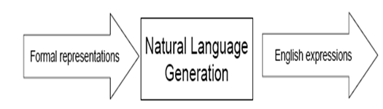
Natural Language Generation(NLG)
NLG is much simpler to accomplish. NLG translates a computer’s artificial language into text, and can also go a step further by translating that text into audible speech with text-to-speech.

Slide 61
NLG v/s NLU
NLG may be viewed as the opposite NLU.
The difference can be :
in natural language understanding the system needs to disambiguate the input sentence to produce the machine representation language,.
in NLG the system needs to make decisions about how to put a concept into words.
The NLU is harder than NLG.

Slide 62
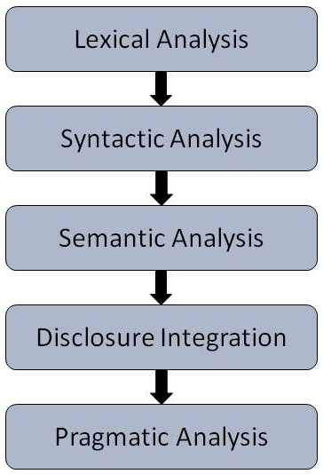
Steps in Natural Language processing
There are general five steps as shown in figure below:

Slide 63
Contd..
Lexical Analysis:
It involves identifying and analyzing the structure of words.
Lexicon of a language means the collection of words and phrases in a language.
Lexical analysis is dividing the whole chunk of text into paragraphs, sentences, and words.

Slide 64
Contd..
Syntactic Analysis (Parsing):
It involves analysis of words in the sentence for grammar and arranging words in a manner that shows the relationship among the words.
The sentence such as “The school goes to boy” is rejected by English syntactic analyzer.

Slide 65
Contd…
Semantic Analysis:
It draws the exact meaning or the dictionary meaning from the text.
The text is checked for meaningfulness.
It is done by mapping syntactic structures and objects in the task domain.
The semantic analyzer disregards sentence such as “hot ice-cream”.

Slide 66
Contd…
Discourse Integration:
The meaning of any sentence depends upon the meaning of the sentence just before it.
In addition, it also brings about the meaning of immediately succeeding sentence.

Slide 67
Contd..
Pragmatic Analysis:
During this, what was said is re-interpreted on what it actually meant.
It involves deriving those aspects of language which require real world knowledge.

Slide 68
Applications of NLP
Text-to-Speech & Speech recognition
Information Retrieval
Information Extraction
Document Classification
Automatic Summarization
Machine Translation
Story understanding systems
Question answering
Spelling correction
Caption Generation

Slide 69
Assignment
Differentiate between connectionist and Symbolic AI.
What is the difference between human intelligence and machine intelligence ?
Explain McCulloch-Pitts model of neuron.
Compare the performance of a computer and that of a biological neural network in terms of speed of processing, size and complexity, storage, fault tolerance and control mechanism.
How does an artificial neural network model the brain? Describe two major classes of learning paradigms: supervised learning and unsupervised (self-organised) learning. What are the features that distinguish these two paradigms from each other?
Construct a multilayer perceptron with an input layer of six neurons, a hidden layer of four neuron and an output layer of two neurons.
Demonstrate perceptron learning of the binary logic function OR.
Why natural language processing is required in AI System? Differentiate between NLU and NLG.

Slide 70

Thank You !

